Slide 1

Basic Details of the Team and Problem Statement
Ministry/Organization Name/Student Innovation: Ministry of Law and Justice
PS Code: SIH1286 Problem Statement Title: Incentives based Design for onboarding Legal Service Providers such as Advocates, Arbitrators, Mediators, Notaries, Document Writers, etc on eMarket Place for extending Legal Services to Citizens in India
Team Name: Life Compilers
Team Leader Name: Ayush Chugh
Institute Code (AISHE): S-15014
Institute Name: Chandigarh College of Engineering and Technology
Theme Name: Miscellaneous

Slide 2
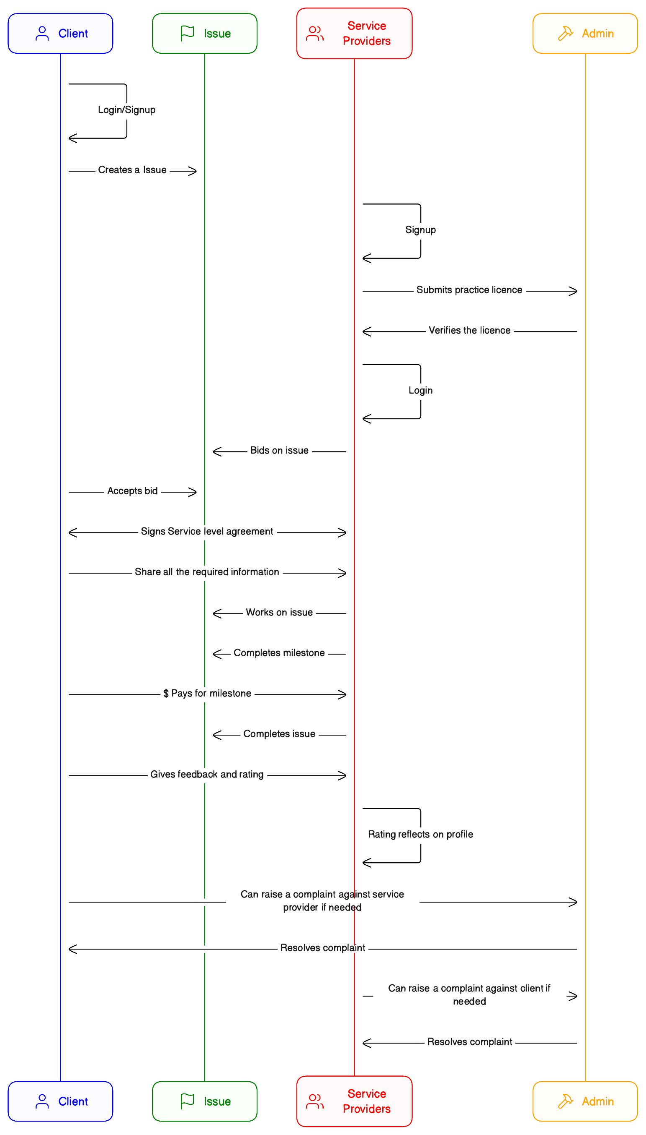
Idea/Approach Details
Describe your idea/Solution/Prototype here:
This project use “bid-based” business model.
Client will post his issue/problem on the platform and set the maximum budget for that.
Service Providers will bid on that problem with their price (price must be under maximum budget set by the user).
Bid made by Service Provider will include milestones and Service provider will be paid based on those milestones
Both Client and Service Providers will have to sign a SLS before starting to work together.
A chat system will be provided so that Client and Service Provider can communicate easily
All the legal documents will be shared through platform itself; this will keep a legal record of all the shared documents
Client will give rating and feedback to Service Provider after completion of the issue/problem.
This rating will be shown in form of Pie Chart and Line graph in service provider’s profile.
Describe your Technology stack here
HTML/CSS
JavaScript
ReactJS
TypeScript
NodeJS
NestJS
Prisma
MongoDB
Firebase
Git/Github

Slide 3
Idea/Approach Details
Describe your Use Cases here
Describe your Dependencies / Show stopper here
Client logins/register
Service provider logins/register
Admin verifies the license of service provider
Client registers a new issue
Service providers bids on that issue
Client accepts the bid
They both sign a Service Level Agreement (SLA)
Client shares all the required information with Service provider through platform only
Service provider works on the issue
Service provider completes the milestone
Client pays for the milestone
Service providers completes the issue
Client gives rating and feedback
Rating reflects on the service provider’s profile
Both service provider and client can raise complaint against each other if needed and the admin will resolve it.
Firebase: All the static files (license proofs) will be uploaded to firebase, so if the firebase crashes than we won’t be able to upload and download any files
Email client: We will use custom email address to send all the emails so if the email client crashes than we won’t be able to send any emails.
Ant.Design: The UI of the project is heavily dependent on the Ant.Design so if Ant.Design makes any major changes, it can effect the UI of the website
Parinoor: A very disgusting person, who don’t does any team work, don’t ask for any opinion, I don’t know what to do, I can’t even kick this person, yeh meri hi glti haa, mujhe maaf krdo, yeh jo aapne ladki ki compulsion kri haa naa ussi ka natija haa, aab maa haara to aapke karan hi haaru gaa, maa chudao bkl. Aa gaya uska message bkl kaa

Slide 4
Team Member Details
Team Leader Name: Ayush Chugh
Branch (Btech/Mtech/PhD etc): Diploma Stream (ECE, CSE etc): CSE Year (I,II,III,IV): II
Team Member 1 Name: Aditya Pant
Branch (Btech/Mtech/PhD etc): Diploma Stream (ECE, CSE etc): CSE Year (I,II,III,IV): II
Team Member 2 Name: Himanshu Sharma
Branch (Btech/Mtech/PhD etc): Diploma Stream (ECE, CSE etc): CSE Year (I,II,III,IV): II
Team Member 3 Name: Satyam
Branch (Btech/Mtech/PhD etc): Diploma Stream (ECE, CSE etc): CSE Year (I,II,III,IV): II
Team Member 4 Name: Parinoor
Branch (Btech/Mtech/PhD etc): Diploma Stream (ECE, CSE etc): CSE Year (I,II,III,IV): II
Team Member 5 Name: Kirti
Branch (Btech/Mtech/PhD etc): Diploma Stream (ECE, CSE etc): CSE Year (I,II,III,IV): II
Team Mentor 1 Name: Sh. Santosh Kumar Yadav
Category (Academic/Industry): Academic Expertise (AI/ML/Blockchain etc): Domain Experience (in years):
Team Mentor 2 Name: Sh. Harinder Singh
Category (Academic/Industry): Industry Expertise (AI/ML/Blockchain etc): Domain Experience (in years):

